Slide 1
Predicting students’ performance
Identifying the best model for predicting low performance students based on lifestyle factors

Slide 2
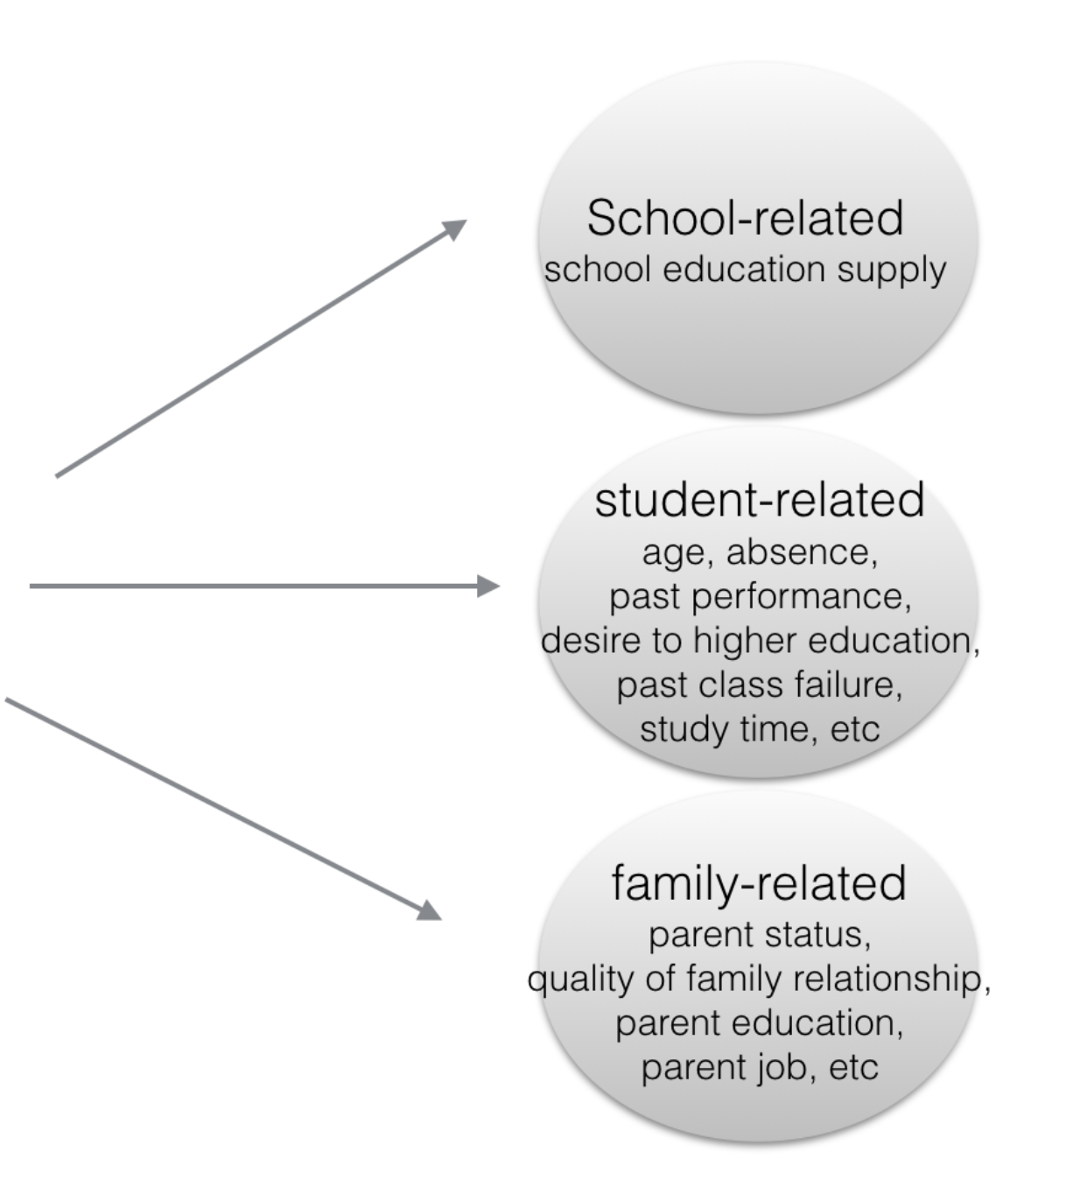
Predicting students’ performance based on lifestyle factors
Data: Student Performance Data Set based on two schools students information.
Source: UCI Machine Learning
649 observations
42 variables
Goal: Predict students who may fail to provide advanced help for them before the exam

Slide 3
Table of features

Slide 4
Histogram of grades

Slide 5
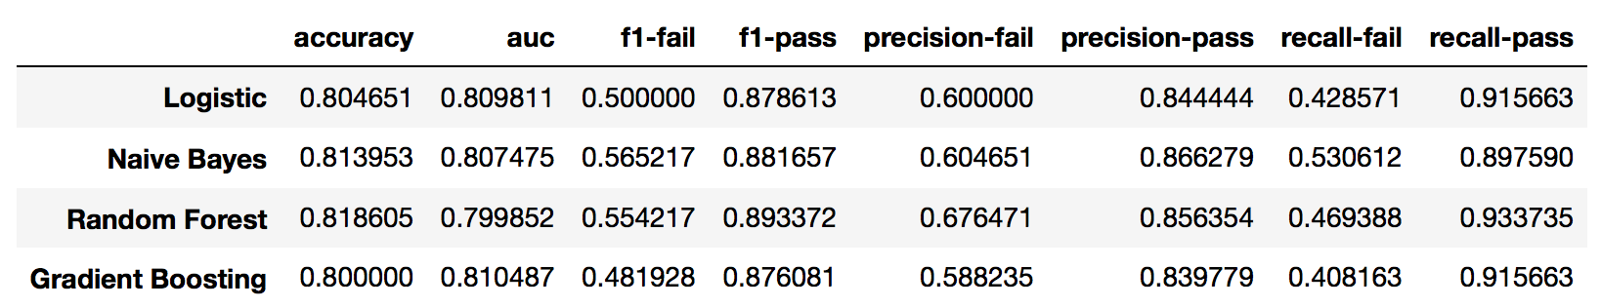
Models’ Comparison
Low recall for “fail”
Objective: Maximize recall for ‘fail’ & AUC

Slide 6
False-Positive False-Negative Trade-off
Threshold to minimize false-negatives
Type I error: high performance students classified as “fail”
Short-run cost: increase in public expenditures
Long-run cost: reinforce student’s education
Type II error: low performance students classified as “pass”
Short-run cost: students don’t get support and fail
Long-run cost: high costs to a Nation’s economy
“Pass”
(negative)
“Fail” (positive)
New threshold = 0.3
More students will be classified as “fail”

Slide 7
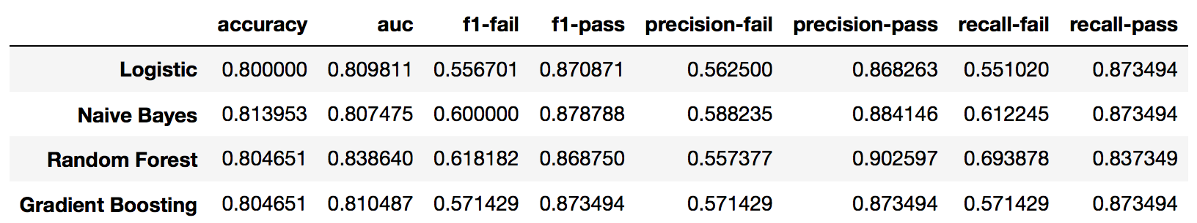
Models’ Comparison (Threshold = 0.3)
Fewer false negatives

Slide 8
Models’ Comparison (Threshold = 0.3)
~70% of ”fail” students were detected
Predicted “Pass”
Predicted “Fail”
Actual “Pass”
TN = 142
FP = 24
Actual “fail”
FN = 15
TP = 34

Slide 9
Web app

Slide 10
Conclusions and Final Thoughts

